Slide 1
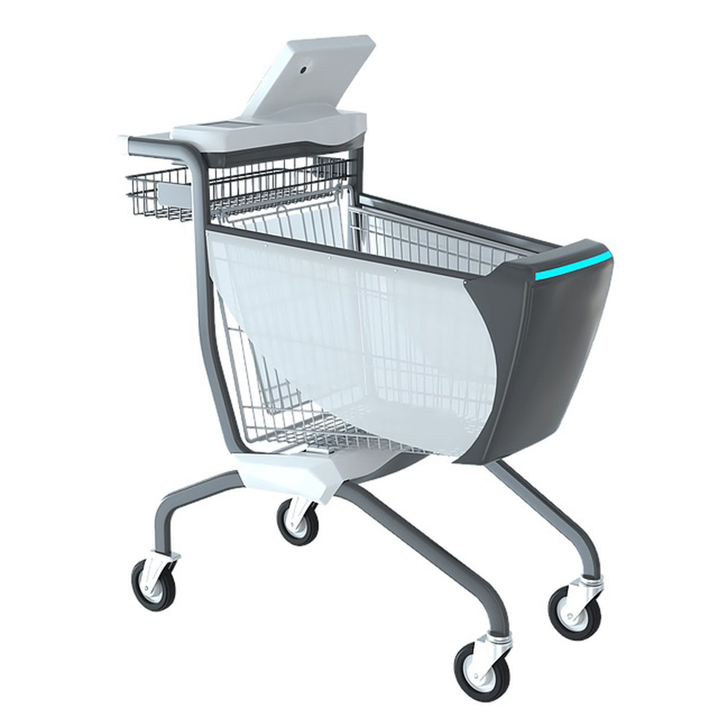
INFO5990: Smart Trolley Inc.
Group T18D-1:
Fatimah Najem N Alsulami (500036657)
Ketan Bambawale (500285875)
Shuhao Liang (500433395)
Dian Rachmanda (500359279)
Shubham Prakash Srivastava (500299300)
Wei Sun (500166714)

Slide 2
Outline
Introduction
Problem & Solution
Justification & Implementation
Working Diagram & Operating frequency of RFID
Recommendation System
Payment System
Anti-theft System

Slide 3

Introduction
Ref: Google Image

Slide 4
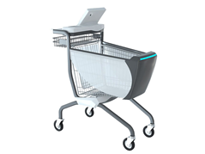
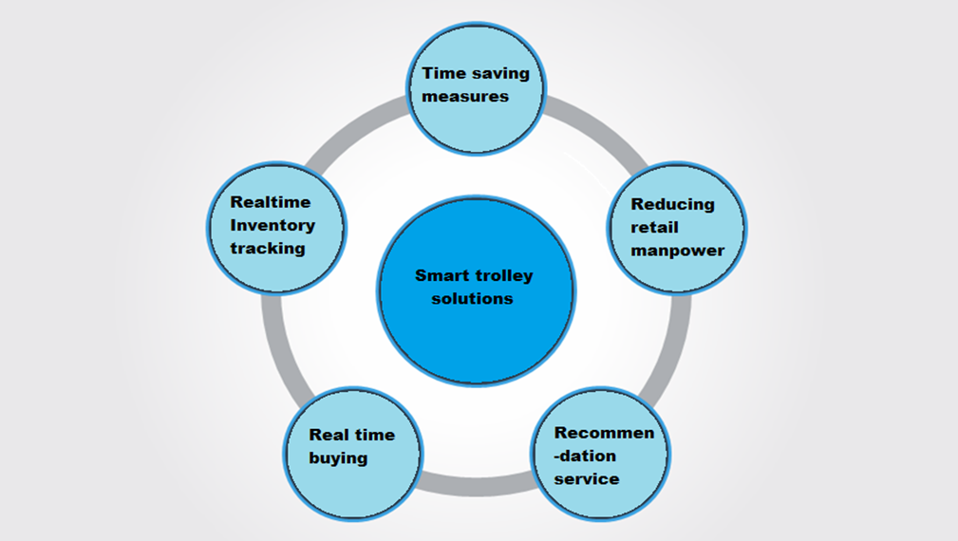
Solution

Slide 5

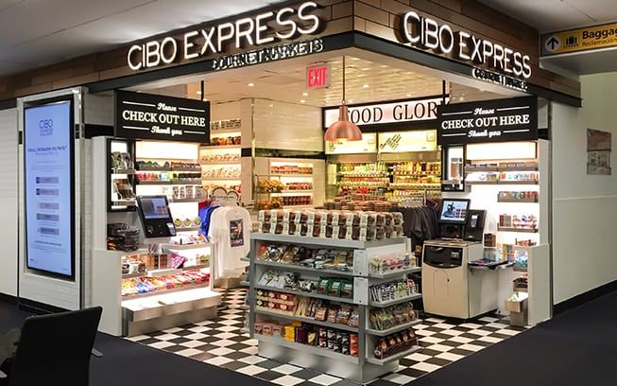
Justification
Ideal shopping experience
Shoplifting - 57 % or $2.6 billion
Gap in the Market
Ref: Google Image

Slide 6
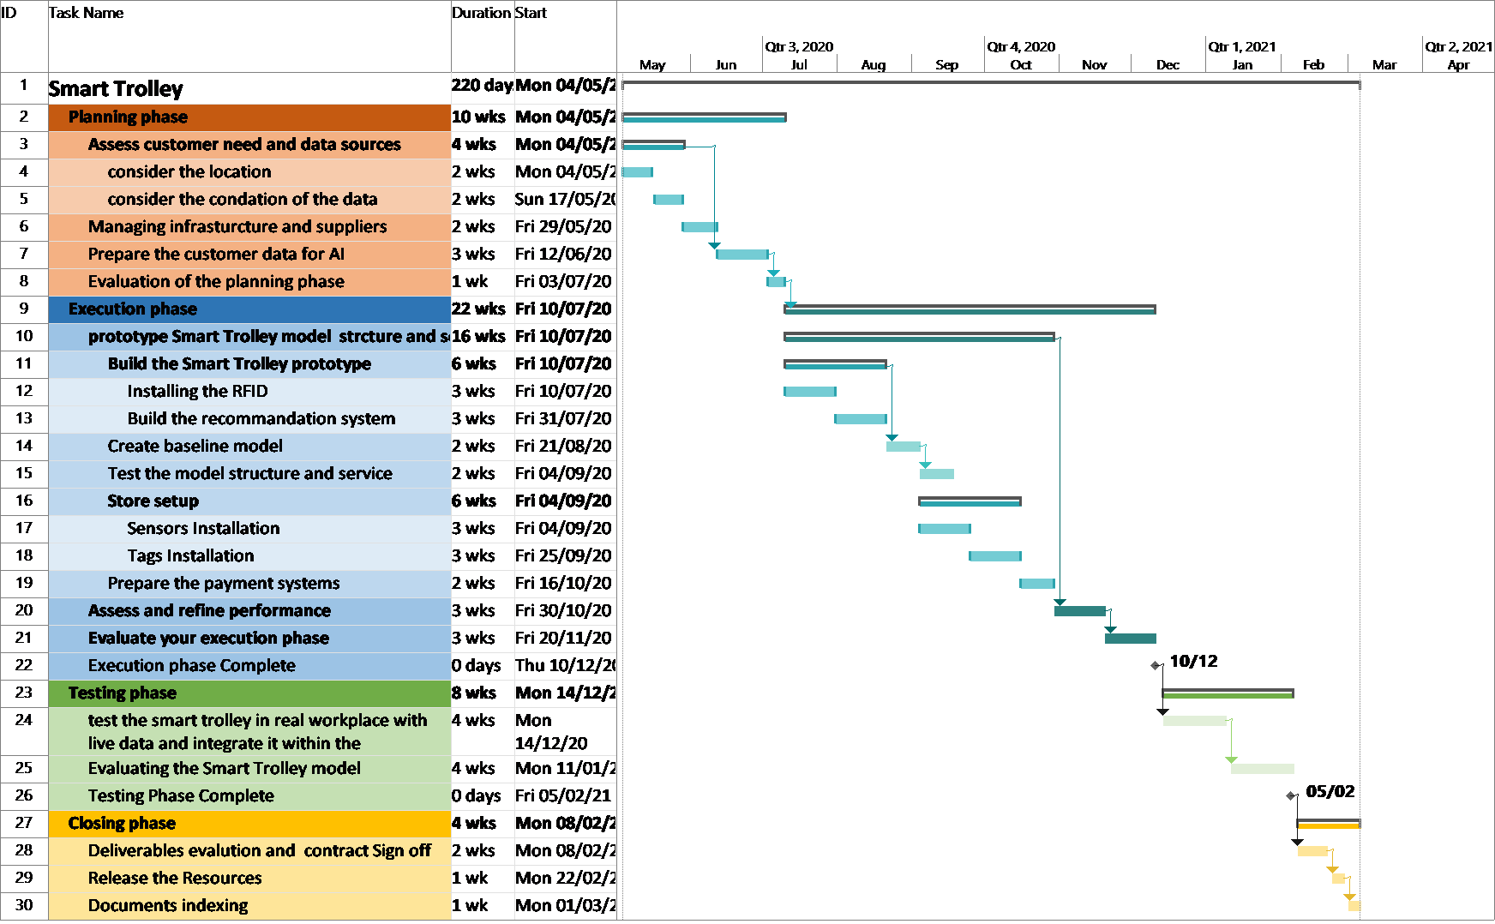
Implementation: WBS & Timeline

Slide 7
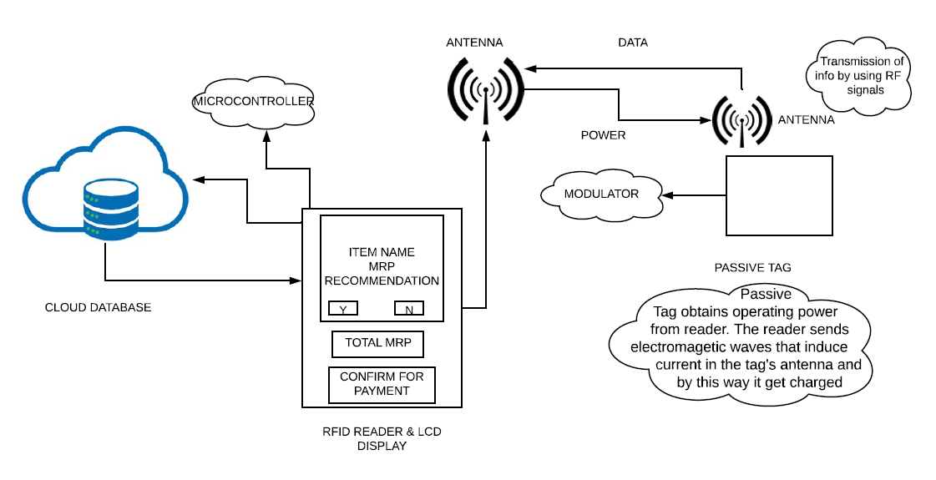
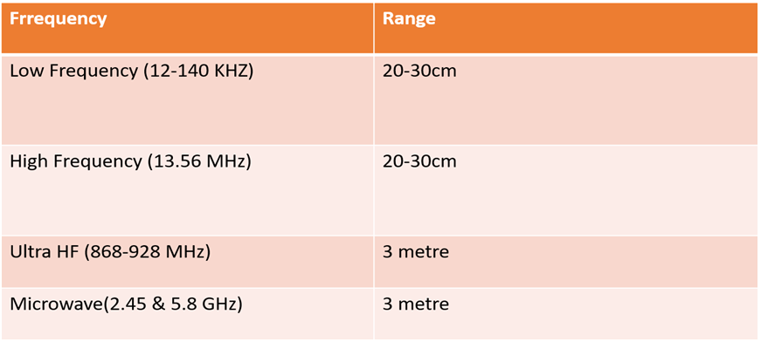
Working Diagram & Operating frequency of RFID
System Operating Frequency :- High Frequency(13.56 MHz).

Slide 8
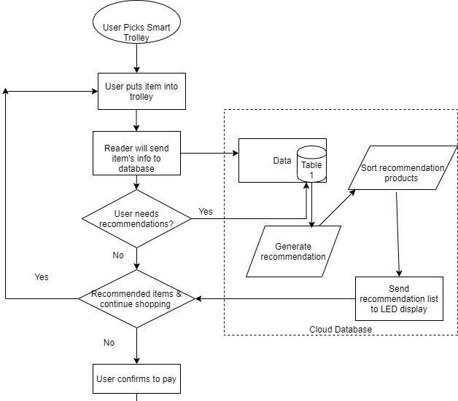
Recommendation System
The recommendation system provides product information and suggestions to customers, helps users decide what products should be purchased, and simulates sales staff to help customers complete the purchase process.
Components
Smart Trolley with RFID signal receiver
LED display is used to accept cloud analysis results, show the content generated by the recommendation system and provide user interaction interface
Cloud server, responsible for data storage and recommendation analysis

Slide 9
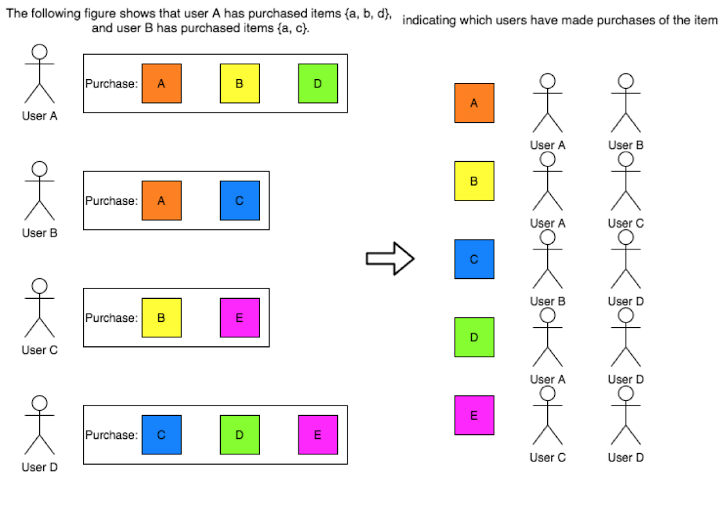
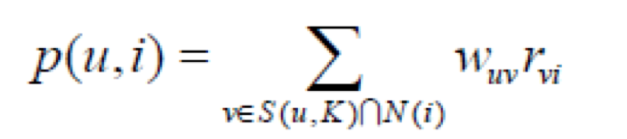
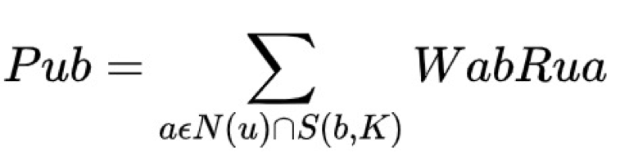
Algorithms used in Recommendation System
User-CF
A user-based collaborative filtering algorithm recommends goods liked by other users who has similar preferences
Item-CF
An item-based collaborative filtering algorithm recommends items that are similar to the items the users purchased previously.

Slide 10
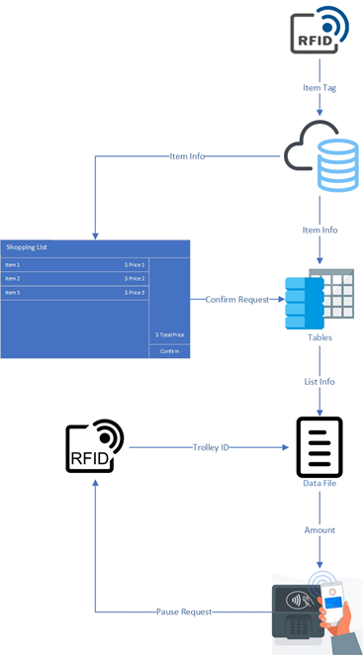
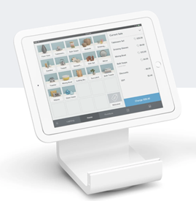

Payment System
•Shopping List Application(SLA)
•Tap Machine
•RFID Reader

Slide 11
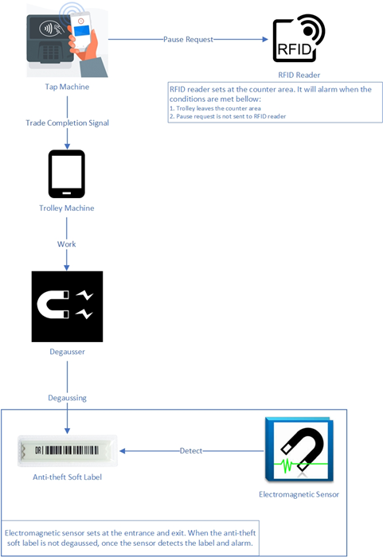
Anti-theft System
•RFID Method:
RFID reader
•EAS Method:
Anti-theft Soft Label
Degausser
Electromagnetic Sensor
*EAS: electronic article surveillance

Slide 12
Issues of the Idea
Complexity in coordination between each component of RFID technology.
Not as user friendly at first.
Non technologically proficient.
Senior citizens.
Application user manual.

Slide 13
Thank You

